Slide 1
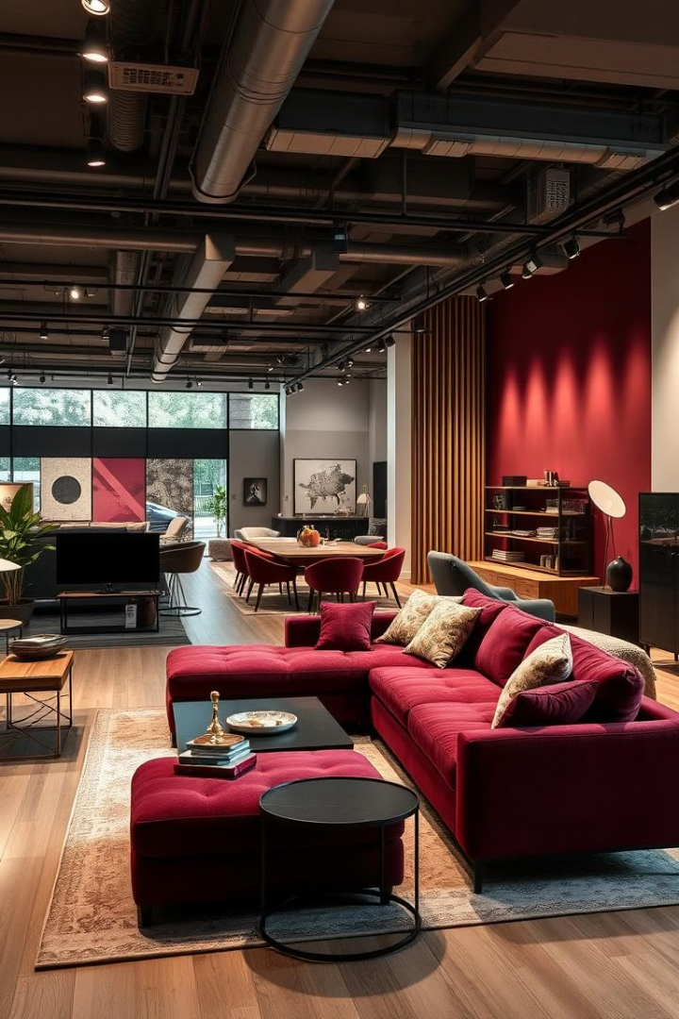

FurniSphere Revolutionizing Furniture Shopping
Welcome to the future of furniture shopping!
by Mussawir Sohail

Slide 2
Problem: The Frustrations of Traditional Furniture Retail
Limited selection, long wait times.
Lack of personalization, confusing pricing.
Difficult returns and poor customer service.

Slide 3

Solution: A Seamless Online Marketplace Experience
Discover a vast selection of curated furniture.
Shop from the comfort of your own home.
Find the perfect piece for your unique style.
Enjoy a smooth and secure checkout process.

Slide 4




Key Features: Visual Search, AR Preview, and Secure Transactions
Visual Search: Instantly find what you're looking for.
AR Preview: Experience furniture in your space.
Secure Transactions: Shop with peace of mind.

Slide 5
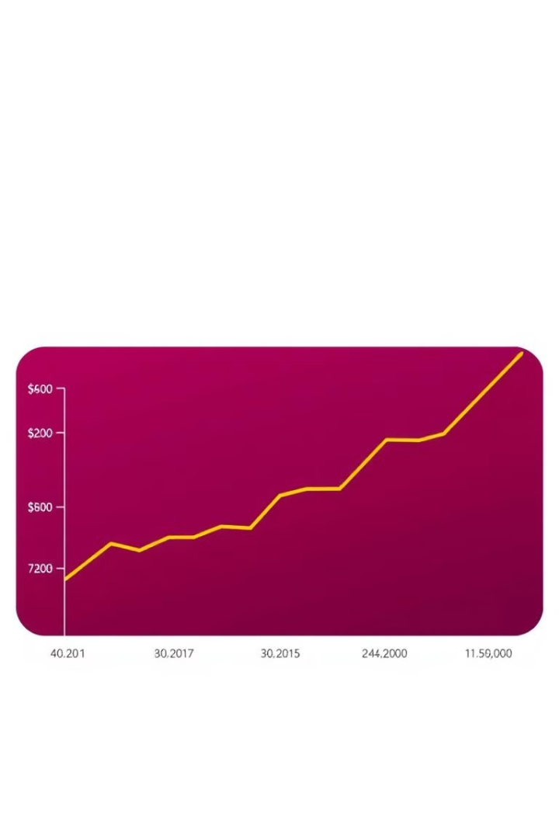
Market Opportunity: Capitalizing on the Growing Online Furniture Market
100B
Market size
Global online furniture market estimated to reach $100 billion by 2025.
30%
Growth rate
Projected annual growth rate exceeding 30%.

Slide 6
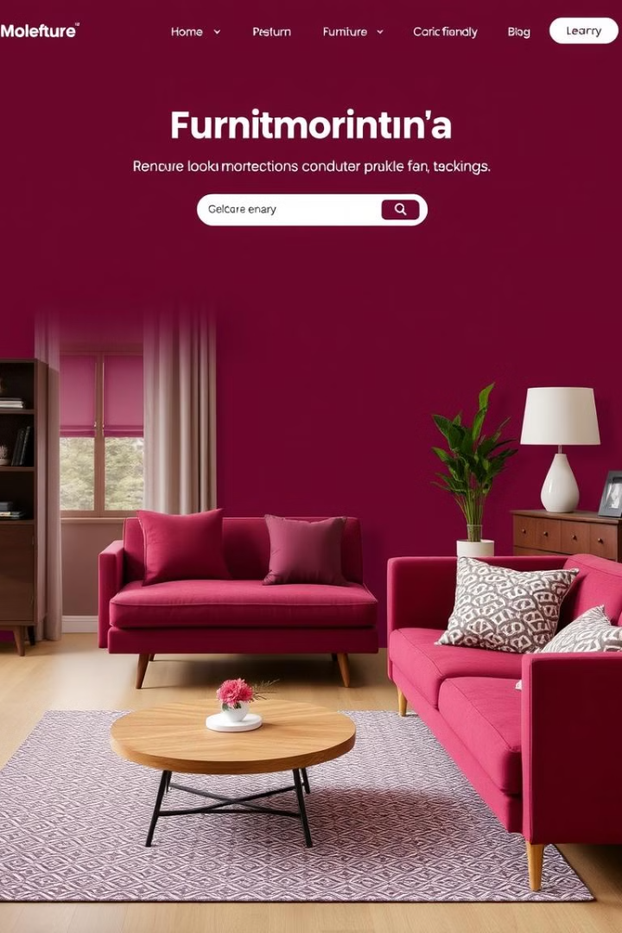
Business Model: Transparent Pricing and Revenue Streams
Direct sales
Subscription plans
Commissions on each furniture sale.
Premium features for vendors and buyers.
Advertising
Targeted ads for furniture brands.

Slide 7
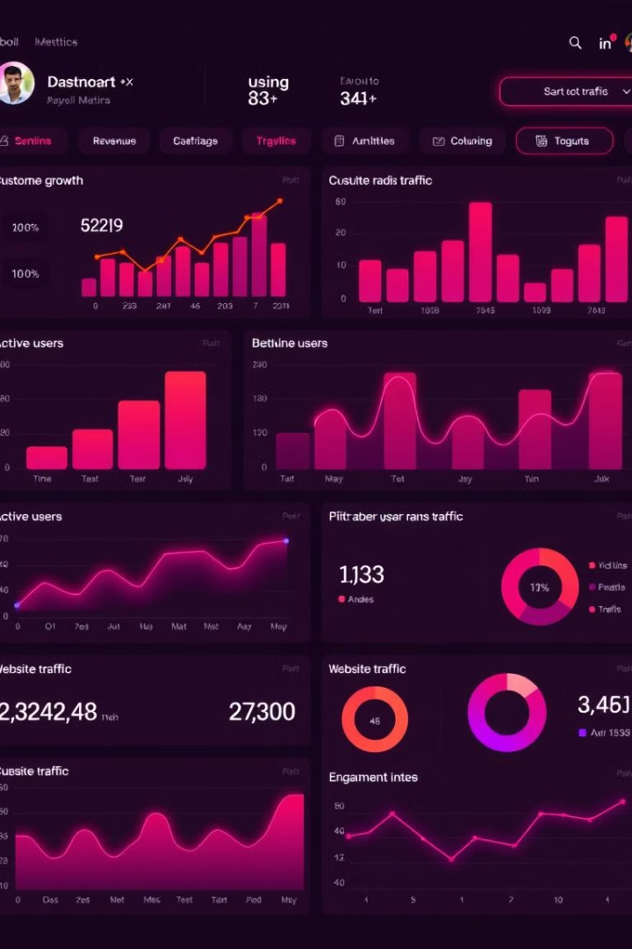
Traction & Milestones: Early Adopters and Growth Metrics
1
Launched beta version in Q2 2023.
2
Reached 5,000 active users by Q3 2023.
3
Secured $1 million in seed funding.

Slide 8

The Future of Furniture Shopping: Investing in FurniSphere
Join us as we revolutionize the furniture industry and make shopping for your dream home easier than ever before.

